Slide 1
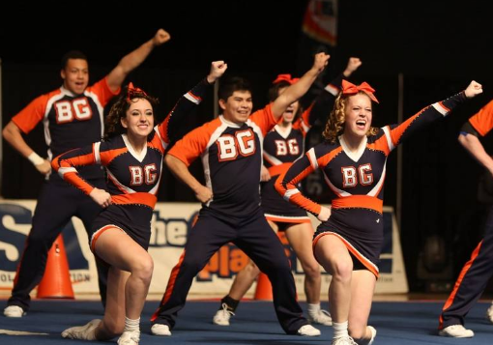
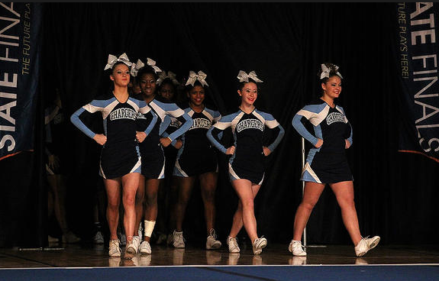
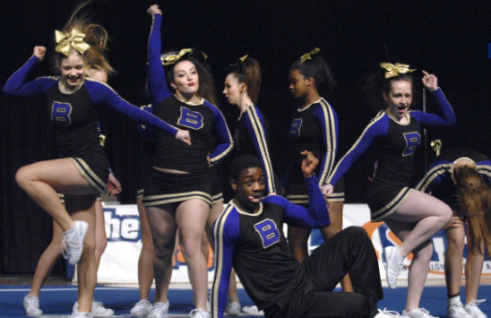
IHSA Competitive Cheerleading
Music Copyright Guidelines

Slide 2
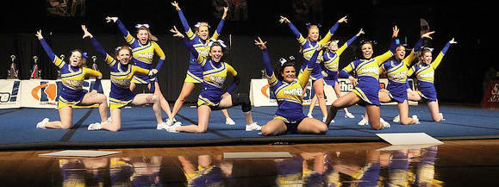
IHSA Competitive Cheer Music Guidelines
The IHSA is committed to offering education-based athletics and activities. With this in mind, we want to make sure our member schools have the information needed to protect students, coaches, and their individual schools from infringing upon copyright laws while competing in competitive cheer.

Slide 3
WHERE DO WE BEGIN?
The copyright law of the United States provides for copyright protection in “musical works, including any accompanying words,” that are fixed in some tangible medium of expression. Musical works include both original compositions and original arrangements or other new versions of earlier compositions to which new copyrightable authorship has been added. The owner of copyright in a work has the exclusive right to make copies, to prepare derivative works, to sell or distribute copies, and to perform the work publicly. Anyone else wishing to use the work in these ways must have the permission of the author or someone who has derived rights through the author. - United State Copyright Office, Library of Congress

Slide 4
Lets Get Started With The Basics…
A copyright is actually a "bundle of rights" that the creator of a work is entitled to control if the work is "an original work of authorship fixed in a tangible medium of expression."
This means that in order to be entitled to copyright protection, the work has to be something you created (and didn't copy from another work) and set down in some physical form, like in writing, on videotape, in a sound recording, in a computer program or on a computer screen. The "bundle of rights" that are included in copyright allow the purchaser to:
1. distribute the work, 2. reproduce (or make copies of) the work, 3. display the work, 4. perform the work, and 5. create derivative works based upon the original work. - www.copyrightkids.org/definitions

Slide 5
LET’S START WITH THE BASICS…
Copyright laws are nothing new. The current laws have been in effect since the 1970s and are in place to protect the work created by artists and to ensure they are compensated for their time, energy, and creativity in making the original work. All consumers, not just schools, must adhere to these laws. For the IHSA, it is the responsibility of the school/coach, to make certain the school is in compliance.

Slide 6
LET’S START WITH THE BASICS
Recorded music has 2 separate copyrights. Copyright laws protect the artists who record the music. The rights in the recordings are usually controlled by record labels. In addition, the songwriter(s) who wrote the underlying composition and the artist(s) who performed the music are also protected. The composition rights are usually controlled by music publishers.
- USA Cheer Music Copyrights Educational Initiative

Slide 7
WHO’S INVOLVED WITH COPYRIGHTS?
Artists, Music Producers, Music Editors, and Consumers Artists create the original work. Music Producers (i.e. Unleash the Beats and Power Music) create cover music based on the original work. They also obtain a mechanical license to distribute their work. Music Editors also pay a mechanical licensing fee to edit the cover music into what the consumer wants, such as mixing music, adding voiceovers, etc. Consumers such as schools or teams, may purchase the edited music with their own license that accords them certain rights. http://copyrightuser.org/topics/education/

Slide 8
WHY SHOULD THIS MATTER TO ME?
You can’t violate copyright law. You have to have permission from the copyright owner to make use of the “bundle of rights.” A consumer’s license is only good for a certain period of time and is generally a non-exclusive license. For example, this is what’s written in an Unleash the Beats receipt: This non-exclusive license allows you, the Licensee, to use the Recording in the production of one school/team cheer performance mix or competition. That being said, 2 schools can’t purchase one license and “share” music. Each license is good for one school’s routine. If you have a junior high and a high school performing the same routine with the same music, the music must be purchased separately.

Slide 9
WHY SHOULD THIS MATTER TO ME?
Q: I purchase music all the time and listen to it, I’ve never had to purchase a license before. What’s happening now? A: Remember, while copyright laws are not anything new, there were activities being fined by licensing companies for editing and/or mixing music without the proper license. When you purchase personal music to listen to, that doesn’t give you, the purchaser, the bundle of rights. The purchase of music from iTunes, Amazon, or buying a CD allows you to enjoy the music unaltered. It does NOT give you the right to make copies, alter the artist’s original work or do anything else to change what you purchased.

Slide 10
WHY SHOULD THIS MATTER TO ME?
Q: What happens if I violate copyright laws? A: The IHSA cannot give you an exact answer about what will happen because when you violate copyright laws, you’re violating U.S. law. Our expectation is that you purchase the proper license(s) that allows you to edit music if you so desire. If found in violation, you may be subject to financial penalties. The level of responsibility to make sure your school is in compliance rests within the school.

Slide 11
COPYRIGHT GUIDELINES
If your school hosts home contests or competitions, you’ll need to check with the school/district administration regarding SESAC, BMI, and/or ASCAP licenses.
These licenses allow a venue to play music to hundreds of people at one time, such as invitational or competition events. Note: This is not the same as playing music just for yourself (personal use).

Slide 12
COPYRIGHT GUIDELINES
DON’T use mash-ups you create or are sold to you without the documentation of the appropriate license(s).
DON’T illegally download songs without purchasing them.
DON’T copy or distribute to others a recording you have legally purchased.
DON’T edit songs from CDs or that you purchased for personal use.
- USA Cheer Music Copyrights Educational Initiative

Slide 13
COPYRIGHT GUIDELINES
DO your research.
DO purchase a license from the copyright owner to edit and mix music.
DO keep documentation of your legal purchase of your music.
DO work with a company that will provide you with the appropriate documentation for licensing. If a company can’t provide you with the licensing paperwork, choose a different company.
- USA Cheer Music Copyrights Educational Initiative

Slide 14
Resources
If at any time you are unsure of your school’s level of compliance, the IHSA recommends you consult with your school’s legal counsel. The IHSA is not responsible for making sure your license is correct for what you intend to do with the music. In addition, the IHSA expects schools to be aware of their level of compliance with U.S. copyright laws.
https://www.youtube.com/watch?v=FgIYUn1X5wE&feature=youtu.be

Slide 15
Resources
U.S. Copyright Office – Library of Congress www.copyright.gov
USA Cheer Music Copyrights Educational Initiative www.usacheer.net
Varsity
www.varsity.com
Copyright Kids www.copyrightkids.org/definitions
Illinois Drill Team Association www. idta.org
National Federation of State High School Associations www.nfhs.org - FREE Music and Copyrights course coming soon!
USA Cheer Preferred Music Providers
http://usacheer.net/presssafety/preferred-providers
MUSIC INFORMATION
http://usacheer.net/presssafety/music
Music Copyright Webinar
https://www.youtube.com/watch?v=FgIYUn1X5wE&feature=youtu.be

Slide 16
IHSA Competitive Cheerleading
Music Copyright Guidelines

